Slide 1

Machine Learning Maximum Likelihood Estimation
Indian Institute of Information Technology Sri City, Chittoor

Slide 2
Today’s Agenda
Introduction to Maximum Likelihood Estimation
Maximum likelihood Estimation (MLE) method
General Principle of MLE
General Principle of MLE: Example
MLE - The Gaussian Case: Unknown μ
MLE - The Gaussian Case: Unknown μ and Σ
Additional Resources

Slide 3
Introduction to Maximum Likelihood Estimation
We can design an optimal classifier if we knew the prior probabilities P(ω_{i}) and the class-conditional densities p(x|ω_{i}).
Unfortunately, in ML applications we rarely if ever have this kind of complete knowledge about the probabilistic structure of the problem.
In a typical case we merely have some vague, general knowledge about the situation, together with a number of design samples or training data.
If we know the number of parameters in advance and our general knowledge about the problem permits us to parameterize the conditional densities, then the severity of these problems can be reduced significantly.

Slide 4
Introduction to Maximum Likelihood Estimation
Suppose, for example, that we can reasonably assume that p(x|ω_{i}) is a normal density with mean μ_{i} and covariance matrix Σ_{i}, although we do not know the exact values of these quantities.
This knowledge simplifies the problem from one of estimating an unknown function p(x|ω_{i}) to one of estimating the parameters μ_{i} and Σ_{i}.
We shall consider two common and reasonable procedures:
Maximum likelihood estimation (MLE)
Bayesian estimation.

Slide 5
Introduction to MLE
Maximum likelihood method view the parameters as quantities whose values are fixed but unknown.
The best estimate of their value is defined to be the one that maximizes the probability of obtaining the samples actually observed.
In contrast, Bayesian methods view the parameters as random variables having some known a priori distribution.
Observation of the samples converts this to a posterior density, thereby revising our opinion about the true values of the parameters

Slide 6
Maximum likelihood Estimation (MLE) method
Maximum likelihood estimation is a method that determines values for the parameters of a model.
Maximum Likelihood Estimation involves treating the problem as an optimization or search problem, where we seek a set of parameters that results in the best fit for the joint probability of the data sample (X).
In Maximum Likelihood Estimation, we wish to maximize the probability of observing the data from the joint probability distribution given a specific probability distribution and its parameters

Slide 7
Maximum likelihood Estimation (MLE) method
Maximum likelihood estimation is a method that determines values for the parameters of a model.
Maximum Likelihood Estimation involves treating the problem as an optimization or search problem, where we seek a set of parameters that results in the best fit for the joint probability of the data sample (X).
In Maximum Likelihood Estimation, we wish to maximize the probability of observing the data from the joint probability distribution given a specific probability distribution and its parameters.
Why MLE Methods?
Always have good convergence properties as the number of training samples increases.
Simpler than alternate methods, such as Bayesian techniques

Slide 8
General Principle of MLE
Suppose that we separate a collection of samples according to class, so that we have c sets, D₁, ...,D_{c}, with the samples in D_{j} having been drawn independently according to the probability law p(x|ω_{j}).
We say such samples are i.i.d. — independent identically distributed random variables.
We assume that p(x|ω_{j}) has a known parametric form, and is therefore determined uniquely by the value of a parameter vector θ_{j}.
Our problem is to use the information provided by the training samples to obtain good estimates for the unknown parameter vectors θ₁, ..., θ_{c} associated with each category.

Slide 9
General Principle of MLE: example
Assume that we might have p(x|ω_{j}) ∼ N(μ_{j} ,Σ_{j} ), where θ_{j} consists of the components of μ_{j} and Σ_{j} .
Our problem is to use the information provided by the training samples (x) to obtain good estimates for the unknown parameter vector θ_{j}, that is, estimating μ_{j} and Σ_{j} for each θj.
To show the dependence of p(x|ω_{j}) on θ_{j} explicitly, we write p(x|ω_{j}) as p(x|ω_{j} , θ_{j} ).

Slide 10

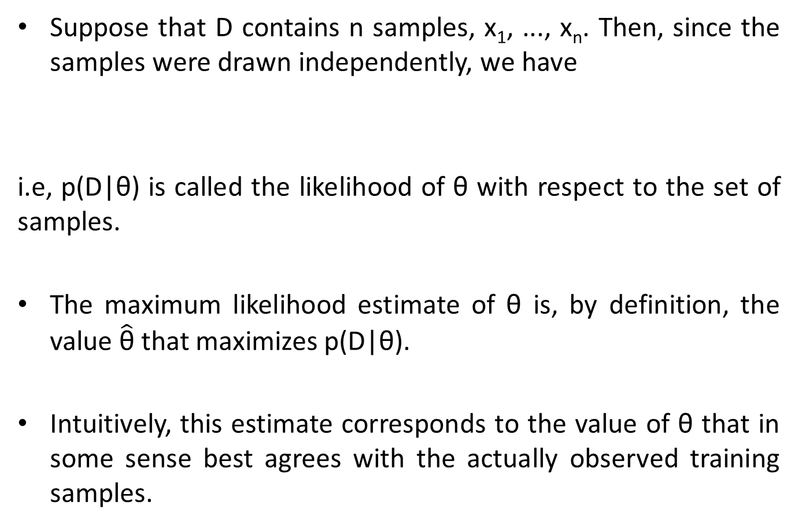
General Principle of MLE: example
Suppose that D contains n samples, x₁, ..., x_{n}. Then, since the samples were drawn independently, we have
i.e, p(D|θ) is called the likelihood of θ with respect to the set of samples.
The maximum likelihood estimate of θ is, by definition, the value $\hat{\text{θ}}$ that maximizes p(D|θ).
Intuitively, this estimate corresponds to the value of θ that in some sense best agrees with the actually observed training samples.
Eq. 1

Slide 11
MLE: example
Credits: William Fleshman
https://towardsdatascience.com/maximum-likelihood-estimation-984af2dcfcac

Slide 12
MLE: Example
Several training points in one dimension, known or
assumed to be drawn from a Gaussian of a particular variance, but unknown mean
Four infinite no of source distribution in trainset
likelihood p(D|θ) as a function of the mean
The value that maximizes the likelihood.
It also Maximizes the log-likelihood l(θ).

Slide 13
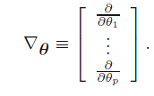
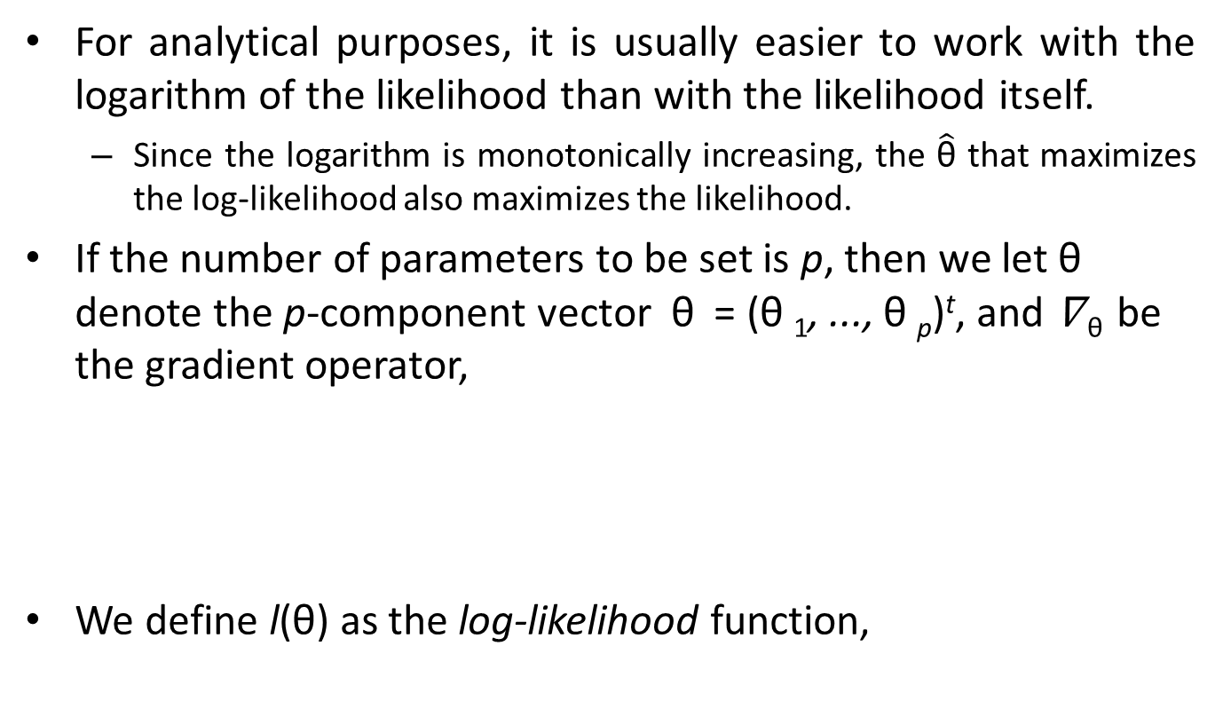
General Principle of MLE: example
For analytical purposes, it is usually easier to work with the logarithm of the likelihood than with the likelihood itself.
Since the logarithm is monotonically increasing, the $\hat{\text{θ}}$ that maximizes the log-likelihood also maximizes the likelihood.
If the number of parameters to be set is p, then we let θ denote the p-component vector θ = (θ ₁, ..., θ _{p})^{t}, and ∇ _{θ} be the gradient operator,
We define l(θ) as the log-likelihood function,

Slide 14
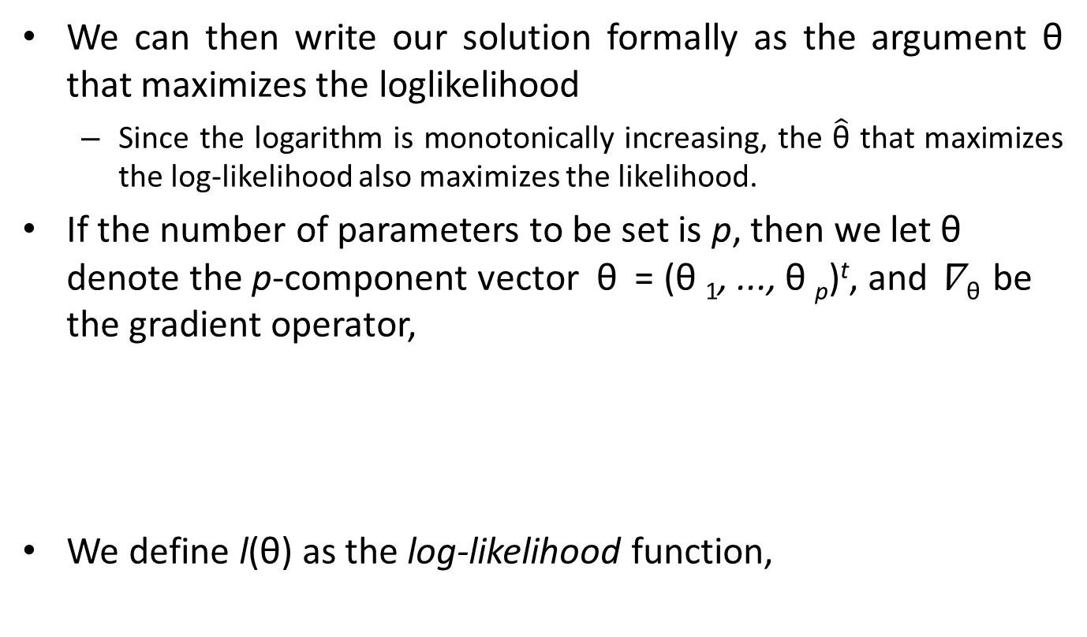
General Principle of MLE: example
We can then write our solution formally as the argument θ that maximizes the loglikelihood
Since the logarithm is monotonically increasing, the $\hat{\text{θ}}$ that maximizes the log-likelihood also maximizes the likelihood.
If the number of parameters to be set is p, then we let θ denote the p-component vector θ = (θ ₁, ..., θ _{p})^{t}, and ∇ _{θ} be the gradient operator,
We define l(θ) as the log-likelihood function,

Slide 15

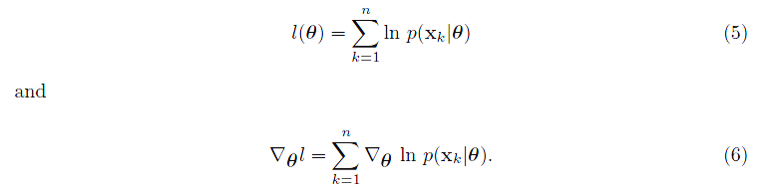

General Principle of MLE: example
We can then write our solution formally as the argument θ that maximizes the loglikelihood, i.e.,
Thus we have from Eq. 1
Thus, set of necessary conditions for the maximum likelihood estimate for θ can be obtained from the set of p equations

Slide 16
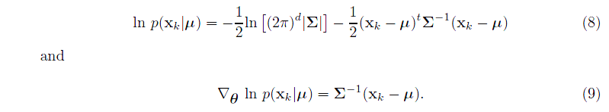
MLE - The Gaussian Case: Unknown μ
To see how maximum likelihood methods results apply to a specific case, suppose that the samples are drawn from a multivariate normal population with mean μ and covariance matrix Σ. (For simplicity, consider first the case where only the mean is unknown.)
Under this condition, we consider a sample point x_{k} and find,

Slide 17
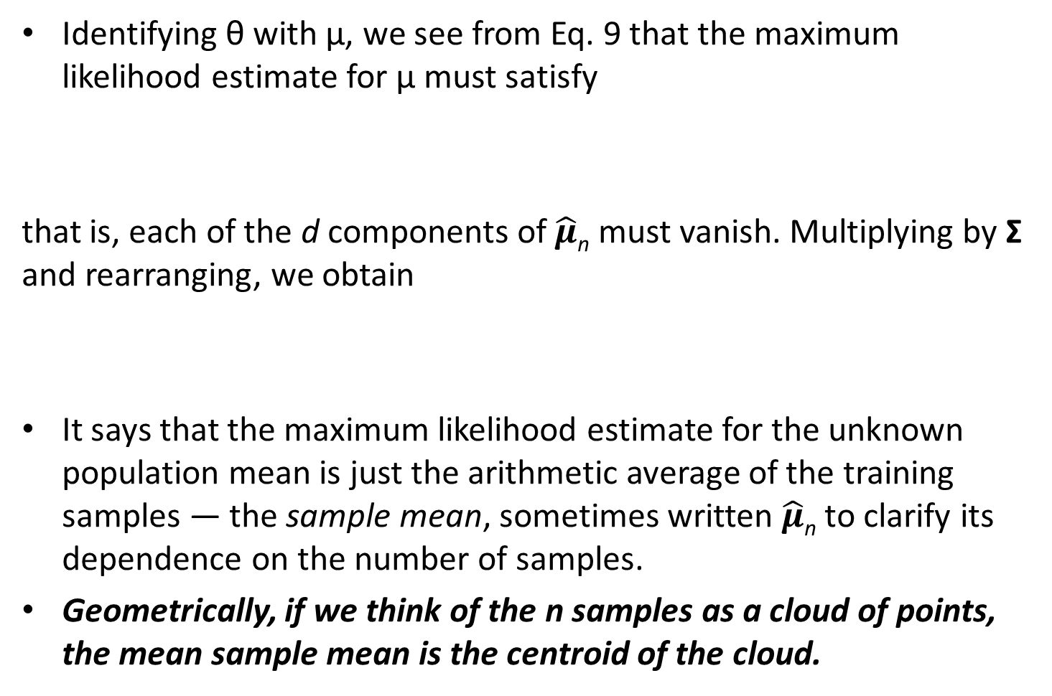
MLE - The Gaussian Case: Unknown μ
Identifying θ with μ, we see from Eq. 9 that the maximum likelihood estimate for μ must satisfy
that is, each of the d components of $\hat{μ}$_{n} must vanish. Multiplying by Σ and rearranging, we obtain
It says that the maximum likelihood estimate for the unknown population mean is just the arithmetic average of the training samples — the sample mean, sometimes written $\hat{μ}$_{n} to clarify its dependence on the number of samples.
Geometrically, if we think of the n samples as a cloud of points, the mean sample mean is the centroid of the cloud.

Slide 18

MLE - The Gaussian Case: Unknown μ and Σ
In the more general (and more typical) multivariate normal case, neither the mean μ nor the covariance matrix Σ is known.
these unknown parameters constitute the components of the parameter vector θ.
Consider first the univariate case with θ₁ = μ and θ₂ = σ₂. Here the log-likelihood of a single point is
and its derivative is,
Consider applying to the full log-likelihood.

Slide 19
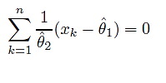
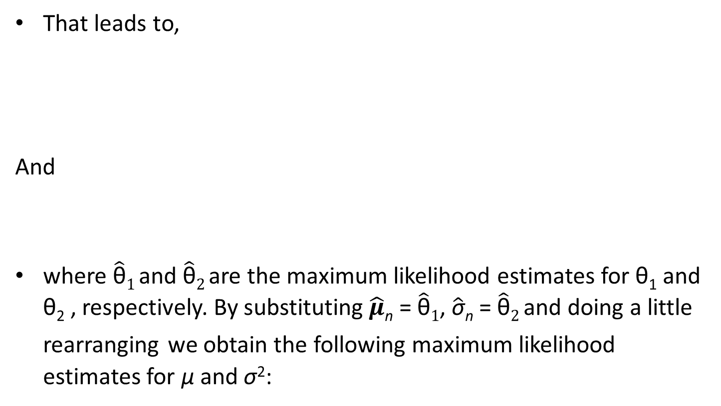
MLE - The Gaussian Case: Unknown μ and Σ
That leads to,
And
where $\hat{\text{θ}}1$and $\hat{\text{θ}}2$ are the maximum likelihood estimates for θ₁ and θ₂ , respectively. By substituting $\hat{μ}$_{n} = $\hat{\text{θ}}1$, $\hat{\text{σ}}$_{n} = $\hat{\text{θ}}2$ and doing a little rearranging we obtain the following maximum likelihood estimates for μ and σ²:

Slide 20
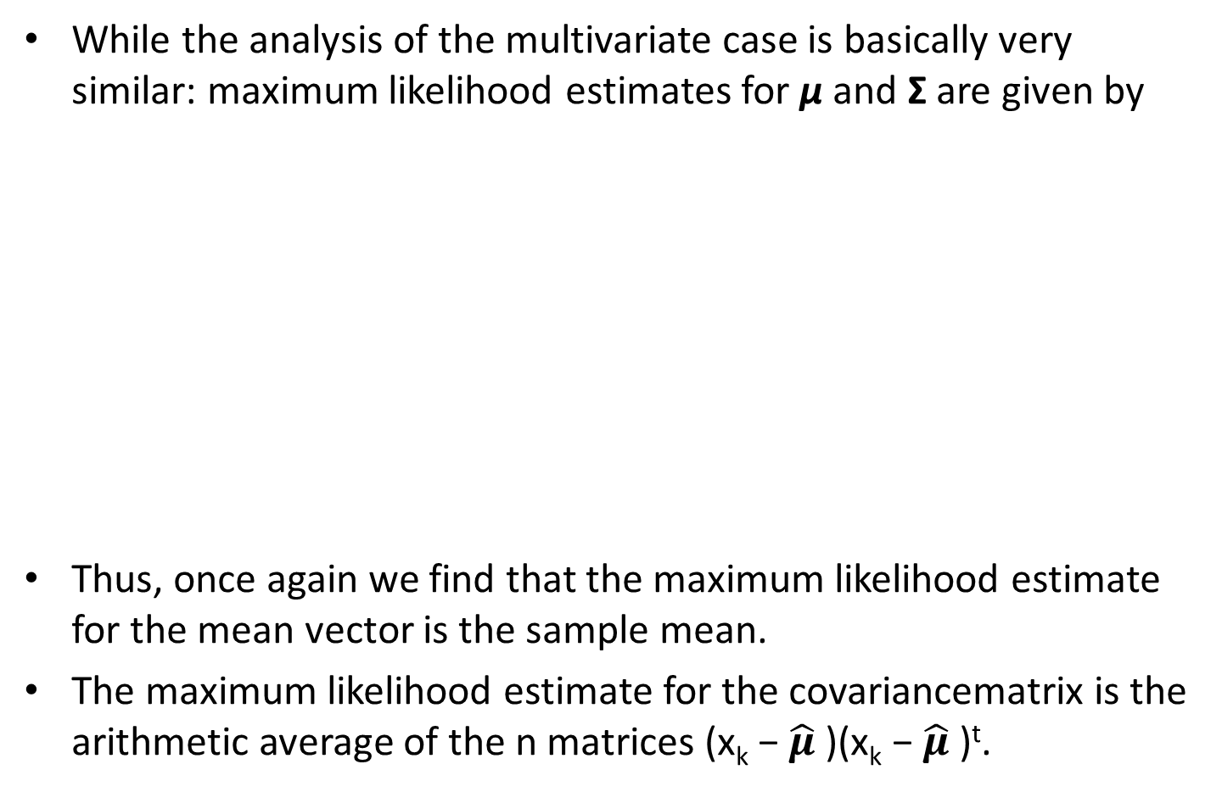
MLE - The Gaussian Case: Unknown μ and Σ
While the analysis of the multivariate case is basically very similar: maximum likelihood estimates for μ and Σ are given by
Thus, once again we find that the maximum likelihood estimate for the mean vector is the sample mean.
The maximum likelihood estimate for the covariancematrix is the arithmetic average of the n matrices (x_{k} − $\hat{μ}$ )(x_{k} − $\hat{μ}$ )^{t}.

Slide 21
Additional Resources:
https://towardsdatascience.com/probability-concepts-explained-maximum-likelihood-estimation-c7b4342fdbb1
https://machinelearningmastery.com/what-is-maximum-likelihood-estimation-in-machine-learning/
Deep Learning, Ian Goodfellow, 2016

